Slide 1
Feature Detection and Matching 特征检测与匹配I
彭小江，博士，副教授
深圳技术大学
邮箱: pengxiaojiang@sztu.edu.cn
主页: https://pengxj.github.io/

Slide 2
本章内容
边缘提取
Hough霍夫变换及其应用

Slide 3

什么是边缘？
图像局部区域特征不相同的那些区域间的分界线
An edge is a place of rapid change in the image intensity function
image

Slide 4
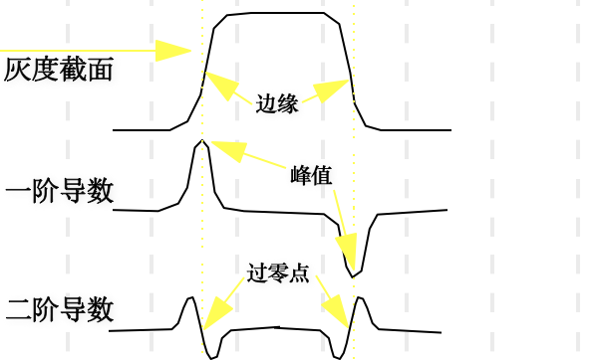
边缘的性质
image

Slide 5
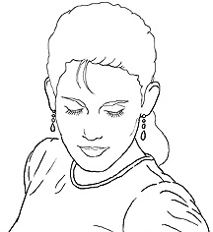
边缘检测
Goal: Identify sudden changes (discontinuities) in an image
Intuitively, most semantic and shape information from the image can be encoded in the edges
More compact than pixels
Ideal: artist’s line drawing (but artist is also using object-level knowledge)

Slide 6
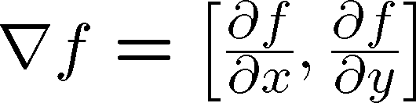
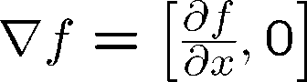

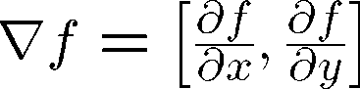
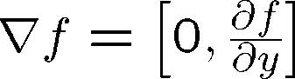
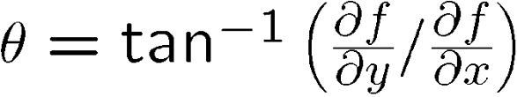
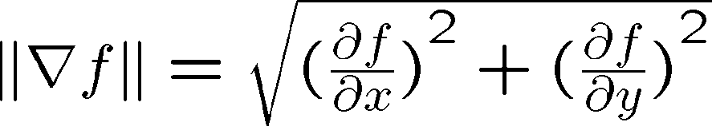
边缘检测—图像梯度
The gradient of an image:
The gradient points in the direction of most rapid increase in intensity
The gradient direction is given by
how does this relate to the direction of the edge?
The edge strength is given by the gradient magnitude

Slide 7
微分->卷积操作
Recall, for 2D function, f(x,y):
We could approximate this as
∂f ≈ f (x_{n+1}, y)− f (x_{n} , y)
∂x Δx
(which is obviously a convolution)
∂f _{= lim}⎛ f (x + ε, y)₋ f (x, y)⎞
⎜ ⎟
∂x
ε→0 ⎝
ε ε
⎠
This is linear and shift invariant, so must be the result of a convolution.
-1
1
-1
1
x,y方向的梯度算子

Slide 8
梯度算子
梯度算子
Roberts算子
Prewitt算子
Sobel算子
Kirsch算子
Laplacian算子
Marr算子

Slide 9
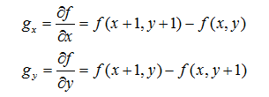
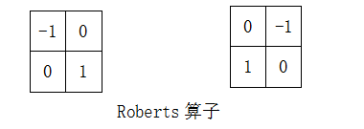
Roberts算子
计算交叉梯度，具有对角优势，边缘定位较准，对噪声比较敏感，但效果较梯度算子略好

Slide 10
Prewitt算子
公式
模板：
特点：
在检测边缘的同时考虑邻近点，能抑止噪声的影响
-1
0
1
-1
-1
-1
-1
0
1
0
0
0
-1
0
1
1
1
1

Slide 11
Sobel算子
考察它上下、左右邻点灰度的加权差。与之接近的邻点的权大：
特点：
对4邻域采用加权方法计算差分
能进一步抑止噪声
但检测的边缘较宽

Slide 12
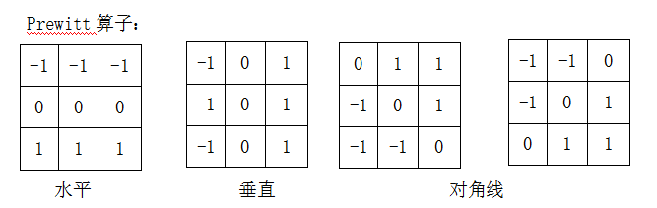
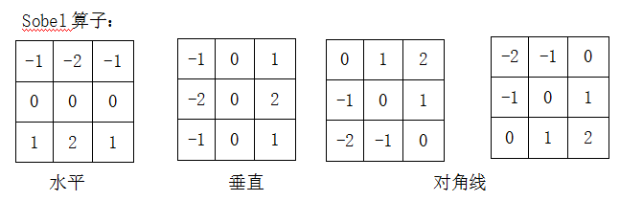
Prewitt vs Sobel

Slide 13
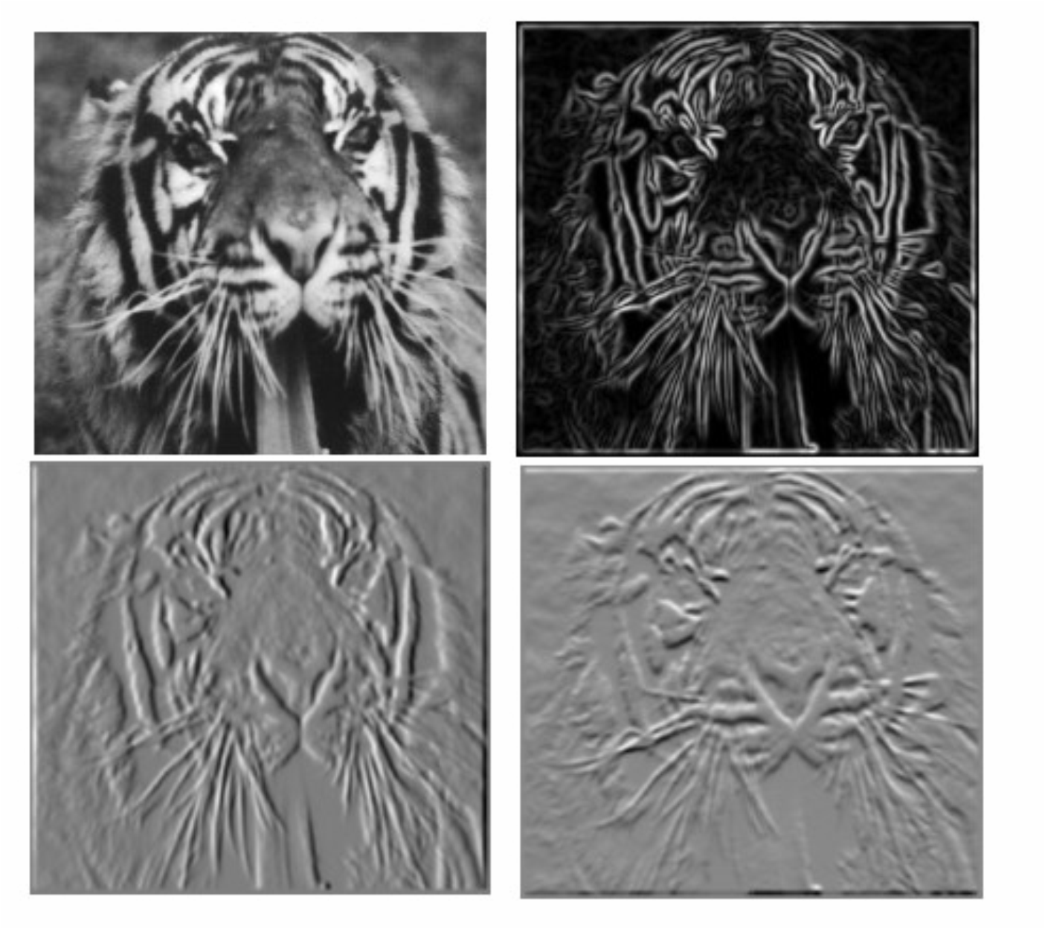
举例
Which one is the gradient in the x-direction (resp. y-direction)?

Slide 14
拉普拉斯算子
二阶微分：通过拉普拉斯来计算
特点：二阶微分在陡然变亮的一边是正的，在变亮陡然放缓的一边是负的。常数部分为零。
用途：
1）二次导数的符号，用于确定边上的像素是在亮的一边，还是暗的一边。
2）0跨越，确定边的准确位置

Slide 15
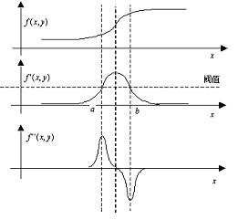
二. 二阶差分算子

Slide 16
拉普拉斯算子
定义：
二维函数f(x,y)的拉普拉斯算子是一个二阶的微分，定义为： ∇²f = [∂²f / ∂x² , ∂²f / ∂y²]
离散形式：
模板：
可以用多种方式被表示为数字形式。对于一个3x3的区域，经验上被推荐最多的形式是：

Slide 17
拉普拉斯算子
0
1
0
1
-4
1
0
1
0
定义数字形式的拉普拉斯算子的基本要求是，作用于中心像素的系数是一个负数，而且其周围像素的系数为正数，系数之和为0。

Slide 18
拉普拉斯算子
0 | 0 | 0 | 6 | -6 | 0 | 0 | 0
0 | 0 | 0 | 3 | 0 | -3 | 0 | 0

Slide 19
拉普拉斯算子
拉普拉斯算子的分析：
优点：
各向同性、线性和位移不变的；
对细线和孤立点检测效果较好。
缺点：
对噪音的敏感，对噪声有双倍加强作用；
不能检测出边的方向；
常产生双像素的边缘。

Slide 20
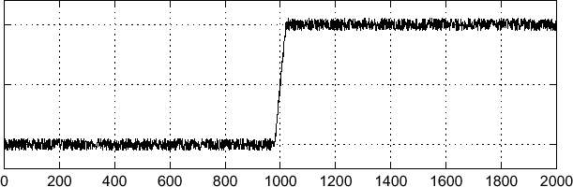
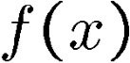
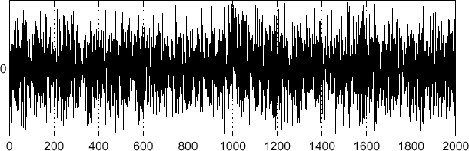
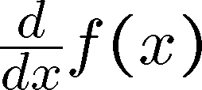
噪声影响
Consider a single row or column of the image
Plotting intensity as a function of position gives a signal
Where is the edge?

Slide 21
噪声影响
由于方向数量有限，前面算子对噪声都比较敏感
解决办法：首先进行平滑滤波

Slide 22
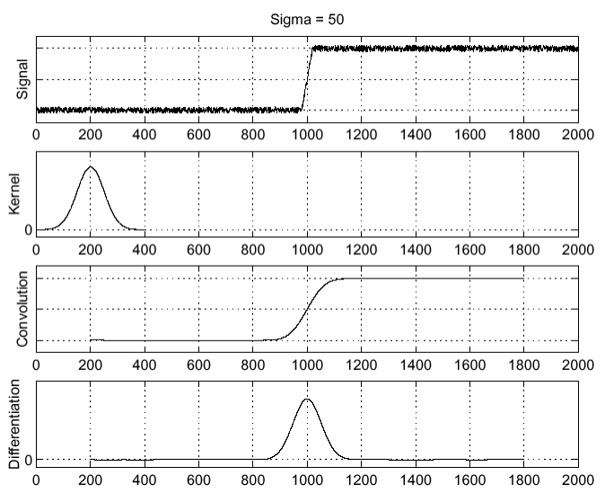
噪声影响-高斯平滑滤波
f
g f * g
^{d} ( f ∗ g) dx
To find edges, look for peaks in
^{d} ( f ∗ g)
dx

Slide 23
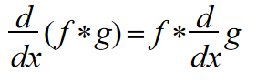
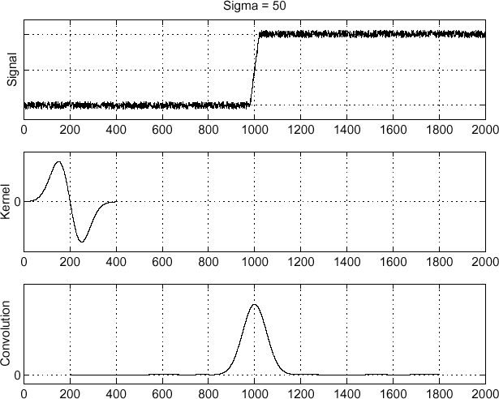
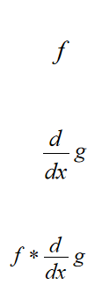
步骤简化
由于梯度可用算子卷积表示，结合律性质：
只要得到高斯核的梯度，就只要一步:
Source: S. Seitz

Slide 24
Canny 边缘检测步骤
Filter image with derivative of Gaussian
Find magnitude and orientation of gradient
Non-maximum suppression:
Thin multi-pixel wide “ridges” down to single pixel width
Linking and thresholding:
Define two thresholds: low and high
Use the high threshold to start edge curves and the low threshold to continue them in neighbors
Source: D. Lowe, L. Fei-Fei

Slide 25

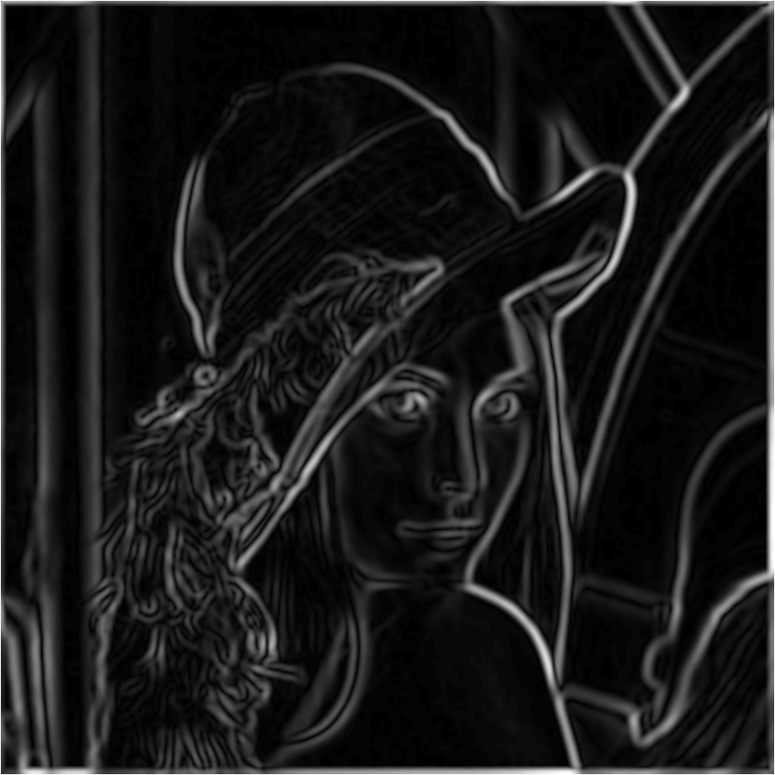
Canny边缘检测效果
original image (Lena)
norm of the gradient

Slide 26
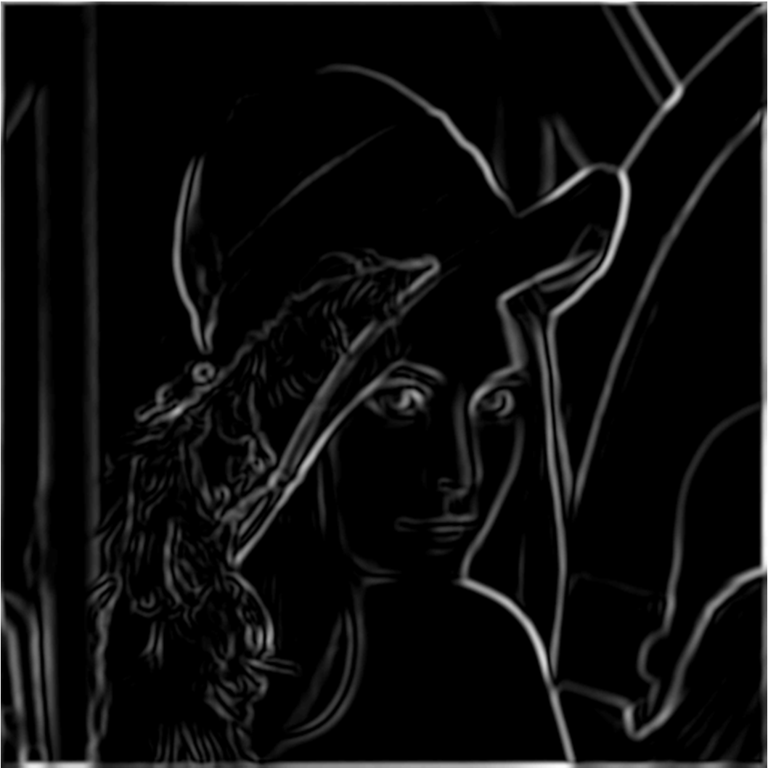
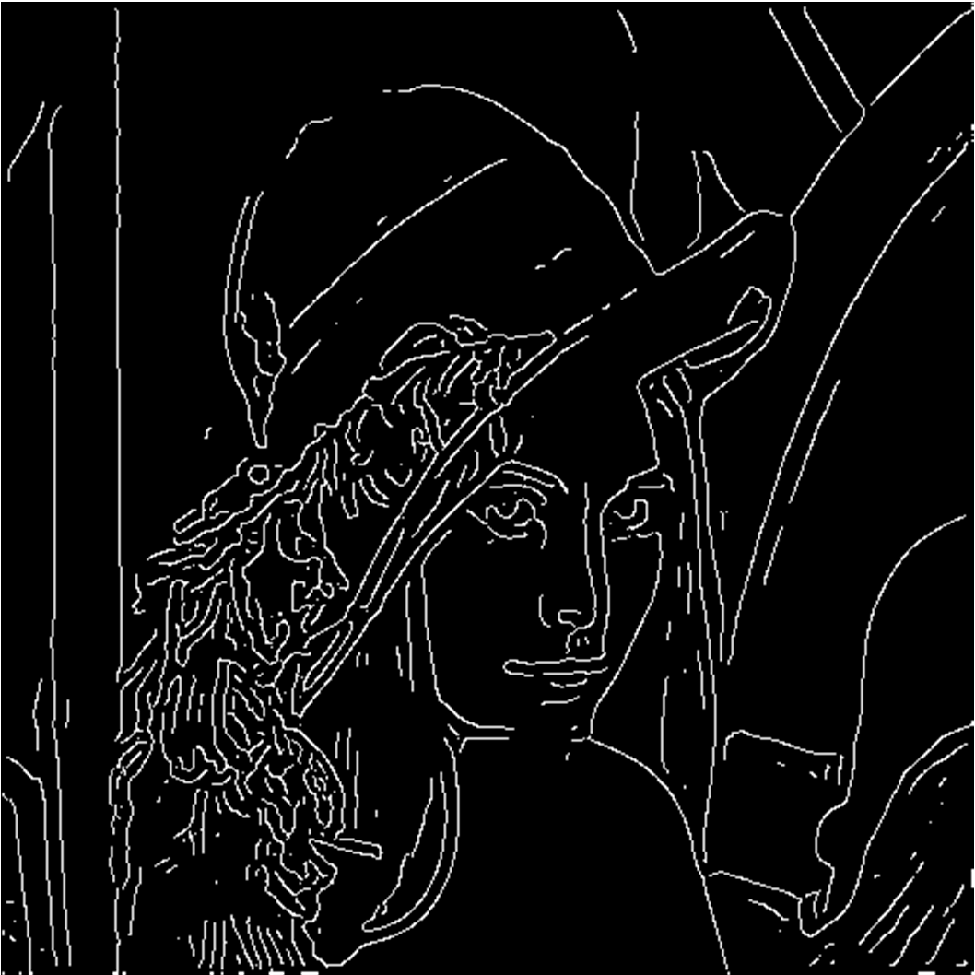
Canny边缘检测效果
thresholding
thinning
(非极大值抑制)

Slide 27
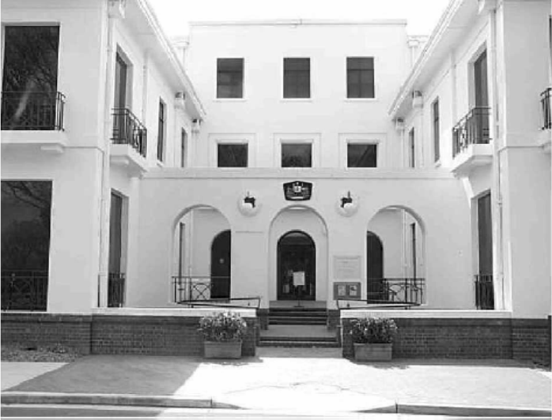
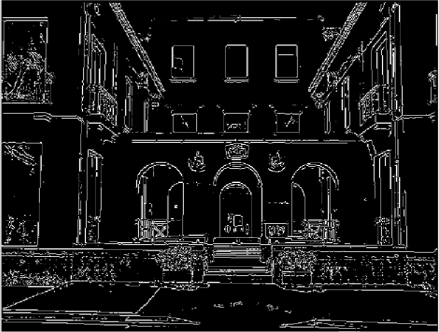
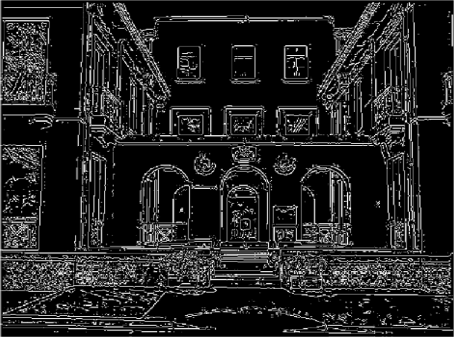
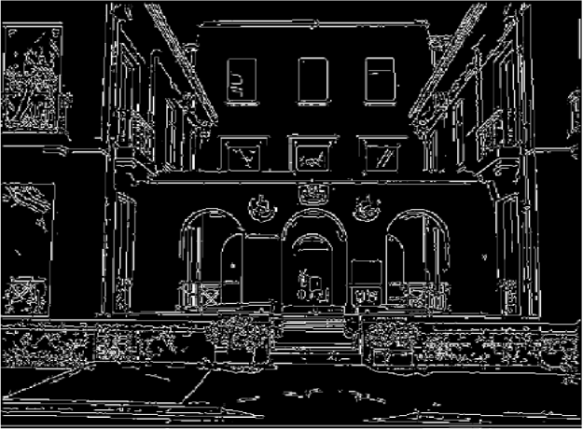
双阈值
阈值低：伪边缘多
阈值高：丢失轮廓
original image
high threshold (strong edges)
low threshold (weak edges)
双阈值
Source: L. Fei-Fei

Slide 28
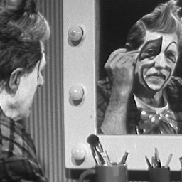
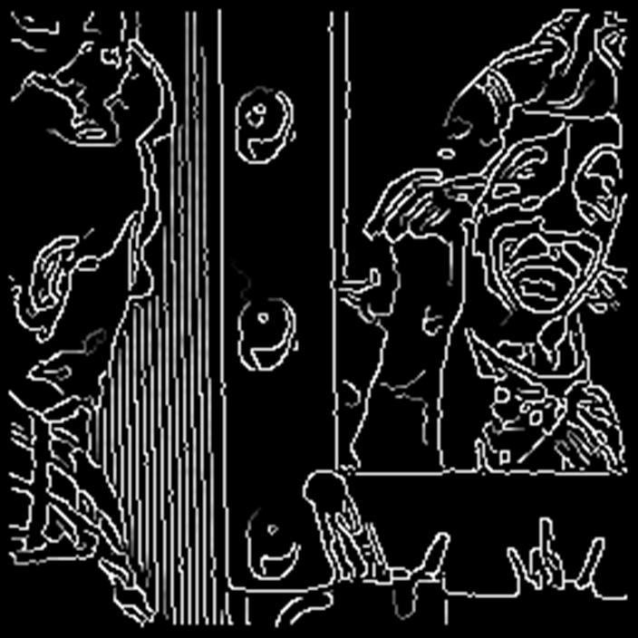
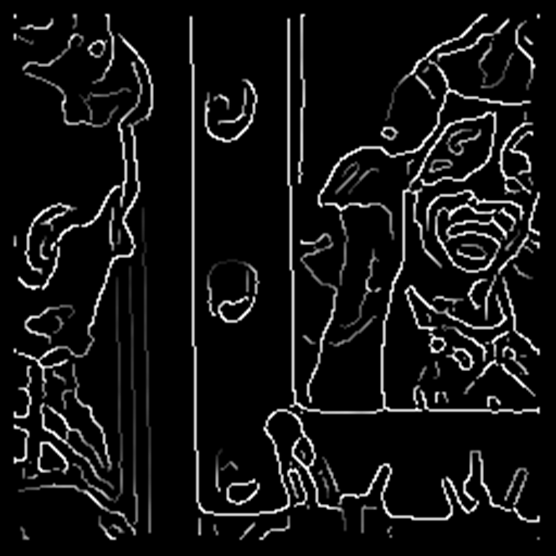


Effect of σ (Gaussian kernel spread/size)
original
Canny with
Canny with
The choice of σ depends on desired behavior
large σ detects large scale edges
small σ detects fine features

Slide 29
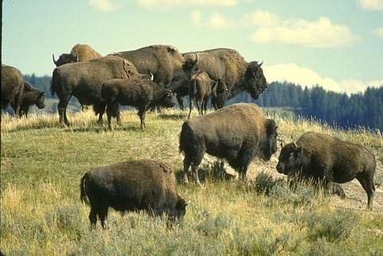
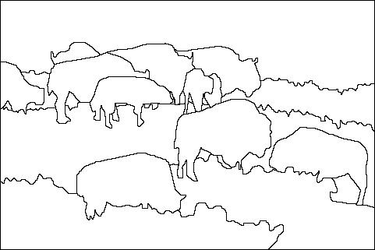
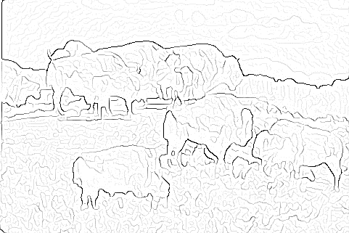

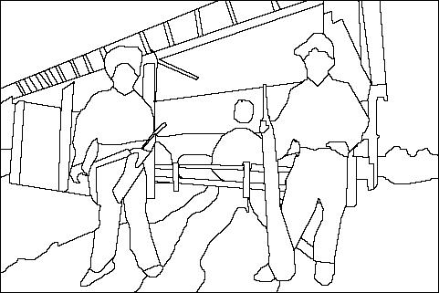
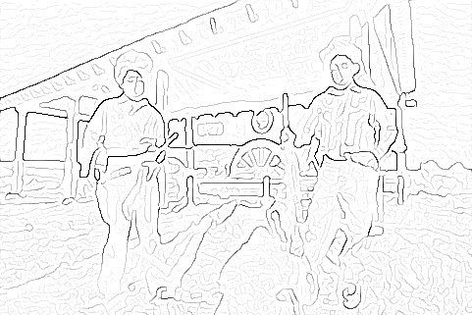
Edge detection is just the beginning…
image
human segmentation
gradient magnitude
Berkeley segmentation database:
http://www.eecs.berkeley.edu/Research/Projects/CS/vision/grouping/segbench/

Slide 30
Hough变换及应用
霍夫变换是一种在图像种寻找直线、圆形以及其他简单形状的方法。1962年Paul Hough首次提出用于直线检测

Slide 31
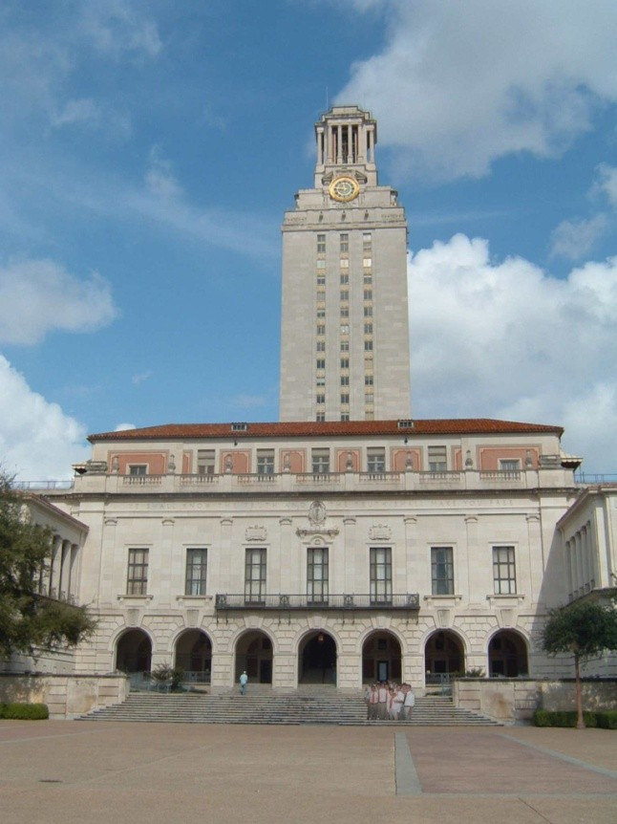
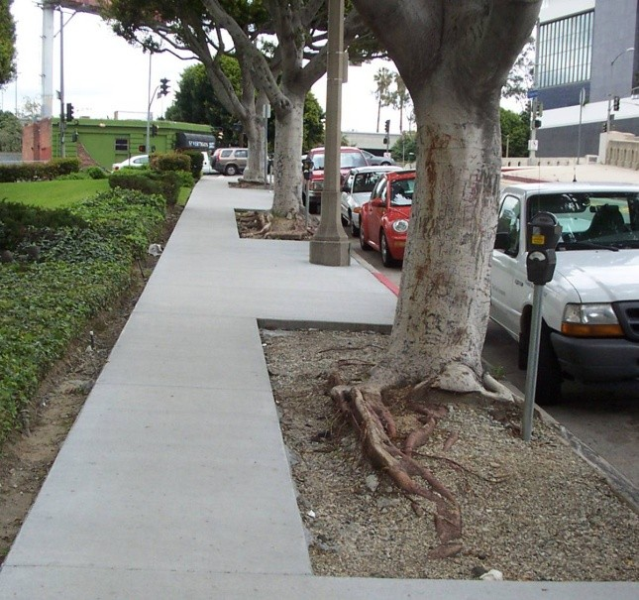
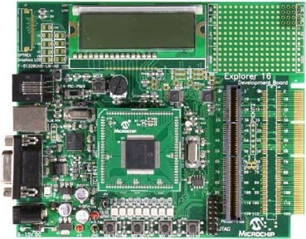
Related: Line detection (fitting)
Why fit lines?
Many objects characterized by presence of straight lines
Why aren’t we done just by running edge detection?

Slide 32
Hough变换检测法
问题的提出
在找出边界点集之后，需要连接，形成完整的边界图形描述

Slide 33
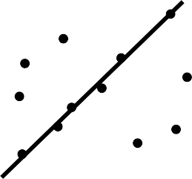
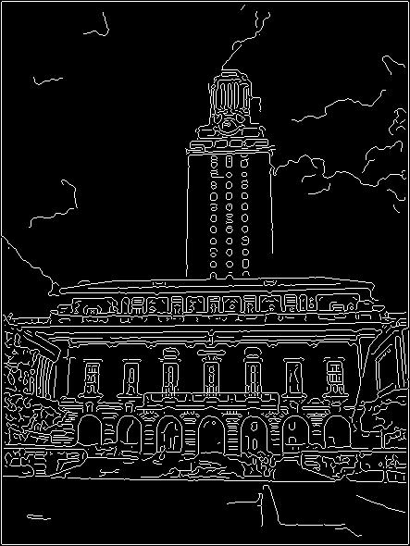
Difficulty of line fitting
Noise in measured edge points, orientations:
e.g. edges not collinear where they should be
how to detect true underlying parameters?
Extra edge points (c):
which points go with which line, if any?
Only some parts of each line detected, and some parts are missing:
how to find a line that bridges missing evidence?

Slide 34
Outliers
Outliers can hurt the quality of our parameter estimates:
E.g. an edge point that is noise, or doesn’t belong to the line we are fitting
Two common ways to deal with outliers, both boil down to voting:
Hough transform
RANSAC

Slide 35
Dealing with outliers: Voting
Voting is a general technique where we let the features
vote for all models that are compatible with it.
Cycle through features, cast votes for model parameters.
Look for model parameters that receive a lot of votes.
Noise & clutter features?
They will cast votes too, but typically their votes should be inconsistent with the majority of “good” features.

Slide 36
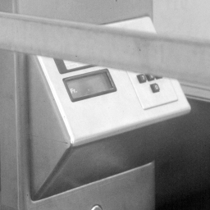
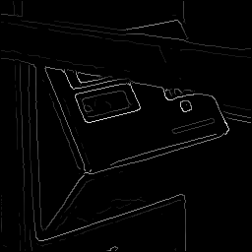
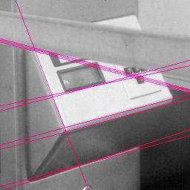
Fitting lines: Hough transform
Given points that belong to a line, what is the line?
How many lines are there?
Which points belong to which lines?
Hough Transform is a voting technique that can be used to answer all of these questions.
Main idea:
Record vote for each possible line on which some edge point lies.
Look for lines that get many votes.

Slide 37
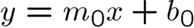
Finding lines in an image: Hough space
Y b
b₀
m₀
x m
image space Hough (parameter) space
Connection between image (x,y) and Hough (m,b) spaces
A line in the image corresponds to a point in Hough space

Slide 38
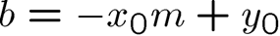
Finding lines in an image: Hough space
y b
y₀
x₀
x
m
Hough (parameter) space
image space
Connection between image (x,y) and Hough (m,b) spaces
A line in the image corresponds to a point in Hough space
What does a point (x₀, y₀) in the image space map to?
Answer: the solutions of b = -x₀m + y₀
This is a line in Hough space
To go from image space to Hough space:
given a pair of points (x,y), find all (m,b) such that y = mx + b

Slide 39

Finding lines in an image: Hough space
y b
(x₁, y₁)
y₀
(x , y )
0 0
b = –x₁m + y₁
m
Hough (parameter) space
x₀
x
image space
What are the line parameters for the line that contains both (x₀, y₀) and (x₁, y₁)?
It is the intersection of the lines b = –x₀m + y₀ and b = –x₁m + y₁

Slide 40
Finding lines in an image: Hough space
y b
x
image space
m
Hough (parameter) space
How can we use this to find the most likely parameters (m,b) for the most prominent line in the image space?
Let each edge point in image space vote for a set of possible parameters in Hough space
Accumulate votes in discrete set of bins; parameters with the most votes indicate line in image space.

Slide 41



Finding lines in an image: Hough space
y
m
x
b
y
m
3 | 5 | 3 | 3 | 2 | 2
3 | 7 | 11 | 10 | 4 | 3
2 | 3 | 1 | 4 | 5 | 2
2 | 1 | 0 | 1 | 3 | 3
x
b

Slide 42
Parameter space representation
Problems with the (m,b) space:
Unbounded parameter domains
Vertical lines require infinite m

Slide 43
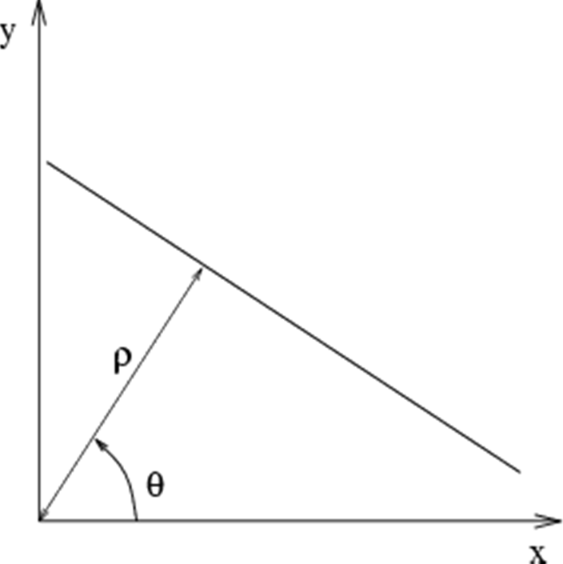
Parameter space representation
Problems with the (m,b) space:
Unbounded parameter domains
Vertical lines require infinite m
Alternative: polar representation
x cosθ + y sinθ = ρ
Each point (x,y) will add a sinusoid in the (θ,ρ) parameter space

Slide 44


Parameter space representation
P.V.C. Hough, Machine Analysis of Bubble Chamber Pictures, Proc. Int. Conf. High Energy Accelerators and Instrumentation, 1959
Use a polar representation for the parameter space Each line is a sinusoid in Hough parameter space
y
ρ
θ
x
θ
Hough space
x cosθ + y sin θ = ρ

Slide 45
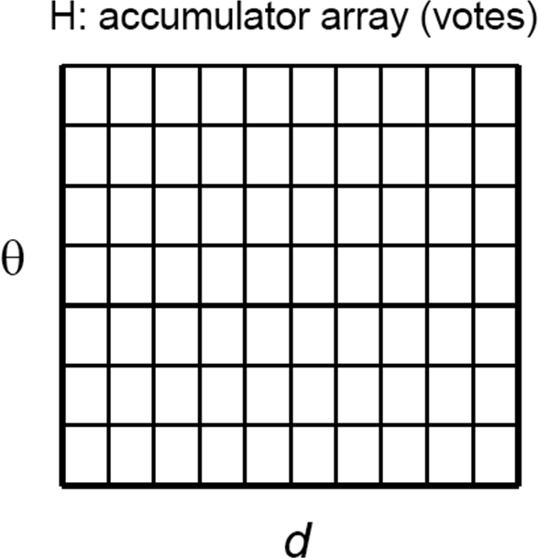
Algorithm outline
Initialize accumulator H to all zeros
For each feature point (x,y) in the image
For θ = 0 to 180
ρ = x cos θ + y sin θ
H(θ, ρ) = H(θ, ρ) + 1
end
end
ρ
θ
Find the value(s) of (θ*, ρ*) where H(θ, ρ) is a local maximum
The detected line in the image is given by
ρ* = x cos θ* + y sin θ*

Slide 46
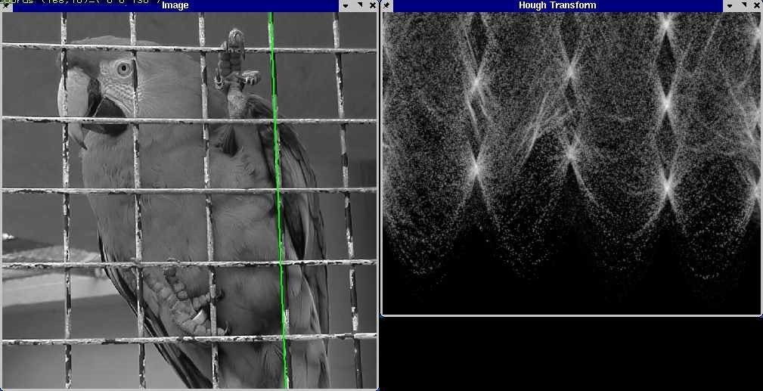
Hough transform example
http://ostatic.com/files/images/ss_hough.jpg

Slide 47


Slide 48

Hough transform for circles
A circle with radius r and center (a, b) can be described as:
x = a + r cos(θ) y = b + r sin(θ)
(x, y)
(a, b)

Slide 49

Hough transform for circles
Circle: center (a, b) and radius r
(x − a)² + ( y − b)² = r ²
i i
For a fixed radius r, unknown gradient direction
b
a
Image space
Hough space

Slide 50

Hough transform for circles
Circle: center (a, b) and radius r
(x − a)² + ( y − b)² = r ²
i i
给定一个半径大小，图像空间的点(x0,y0)对应Hough空间的一个圆
Intersection: most votes for center occur here.
Image space
Hough space

Slide 51



Hough transform for circles
Circle: center (a, b) and radius r
(x − a)² + ( y − b)² = r ²
i i
For an unknown radius r, unknown gradient direction
r
?
b
a
Image space
Hough space

Slide 52





Hough transform for circles
Circle: center (a, b) and radius r
(x − a)² + ( y − b)² = r ²
i i
For an unknown radius r, unknown gradient direction
r
?
b
a
Image space
Hough space

Slide 53



Example: detecting circles
Original
Edges
Votes: Penny
Note: a different Hough transform (with separate accumulators) was used for each circle radius (quarters vs. penny).

Slide 54


Example: detecting circles
Combined detections
Original
Edges
Votes: Quarter
Note: a different Hough transform (with separate accumulators) was used for each circle radius (quarters vs. penny).

Slide 55
Ex5: 边缘提取与霍夫变换
Ch9
Ch10
Ch16

